Slide 1
CHAPTER 4
COMBINATIONAL CIRCUITS
/46

Slide 2
COMBINATIONAL CIRCUITS
In this chapter we look at the different combinational circuits;
Adders
Multiplexer and Demultiplexers
Comparators
Decoders and Encoders
ROMs and PLAs.
/46

Slide 3
Combinational Circuit
A combinational circuit is an interconnected set of gates whose output at any time is a function only of the input at that time. As with a single gate, the appearance of the input is followed almost immediately by the appearance of the output, with only gate delays.
In general terms, a combinational circuit consists of n binary inputs and m binary outputs. As with a gate, a combinational circuit can be defined in three ways:
Truth table: For each of the 2^{n} possible combinations of input signals, the binary value of each of the m output signals is listed.
Graphical symbols: The interconnected layout of gates is depicted.
Boolean equations: Each output signal is expressed as a Boolean function of its input signals.
/46

Slide 4
ADDERS
An adder is a digital circuit in electronics that implements addition of binary numbers.
Adders are of 3 types:
  Half Adder
  Full Adder
  Ripple carry Adder
/46

Slide 5
HALF ADDER
It is a circuit for adding 2, 1 bit quantities.
_{A}
_{B}
A
+ B
Carry Sum
A B S C
0 0 0 0
0 1 1 0
1 0 1 0
1 1 0 1
C = AB
S = AB + AB = A + B
A B
C S
_{C}
_{HA}
_{S}
/46

Slide 6
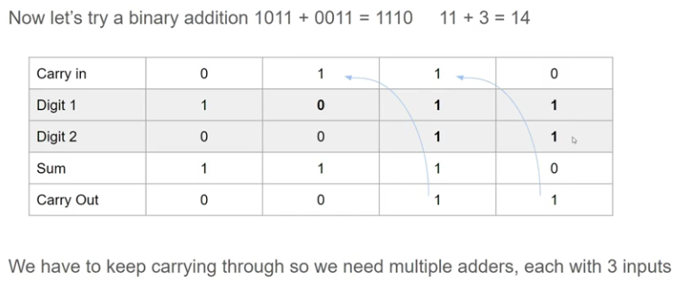
Example: Adding 2 binary numbers.
/46

Slide 7
Full Adder
It is an adder that includes a carry input from a lower order sum.
A B
FA C_{i}
C_{o}
S
C_{O} = ABC + ABC + ABC + ABC
= C(AB + AB) + AB(C + C)
= C(A + B) + AB
S = ABC + ABC + ABC + ABC
= A(BC + BC) + A(BC + BC)
A B Ci S CO
0 0 0 0 0
0 0 1 1 0
0 1 0 1 0
0 1 1 0 1
1 0 0 1 0
0 1 0 1
1 1 0 0 1
1 1 1 1
= A(B + C) + A(B + C)
= A + B + C
/46

Slide 8
FULL ADDER
A B
C_{I}
C_{O} S
/46

Slide 9
Ripple Carry Adder
Read about RIPPLE CARRY ADDER
/46

Slide 10
A Multiplexer (Data Selector)
It is a logical network capable of selecting a single set of data inputs from a number of sets of inputs and it passes the selected inputs to the outputs. It accepts many inputs but gives only one output.
A multiplexer has 2 kinds of inputs, the control inputs and the data inputs. The control inputs are used to select which of the inputs in the data is to be passed through to the outputs.
Some of the common types of multiplexer are 2-to-1, 4-to-1, 8-to-1, 16-to-1 multiplexer.
A₀ A_{n}
Control MUX(n)
Output
/46

Slide 11
Function of Multiplexer
Multiplexer is a digital logic device which is used to perform multiplexing of data. Where, multiplexing simply means sharing of data. Technically, when a particular data is selected from multiple input data sources and transmitted the selected data to a single output channel, it is called multiplexing
/46

Slide 12
2-1 Multiplexer
It has 2 data inputs A and B, one control input , P, and one output, X. When the control input P = 0 the output X is A and when P = 1, X = B
X = PAB + PAB + PAB + PAB
= PA(B + B) + PB(A + A)
= PA + PB
A B
P
X
P A B X
0 0 0 0
0 0 1 0
0 1 0 1
0 1 1 1
0 0 0
1 0 1 1
1 1 0 0
1 1 1 1
/46

Slide 13
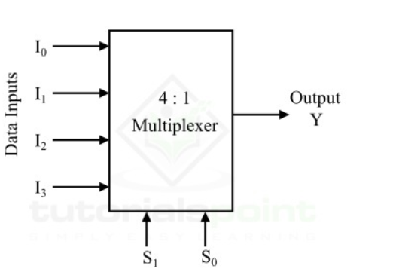
4-1 Multiplexer
4×1 Multiplexer has four data inputs I₃, I₂, I₁ & I₀, two selection lines s₁ & s₀ and one output Y. The block diagram of 4×1 Multiplexer is shown in the following figure
/46

Slide 14
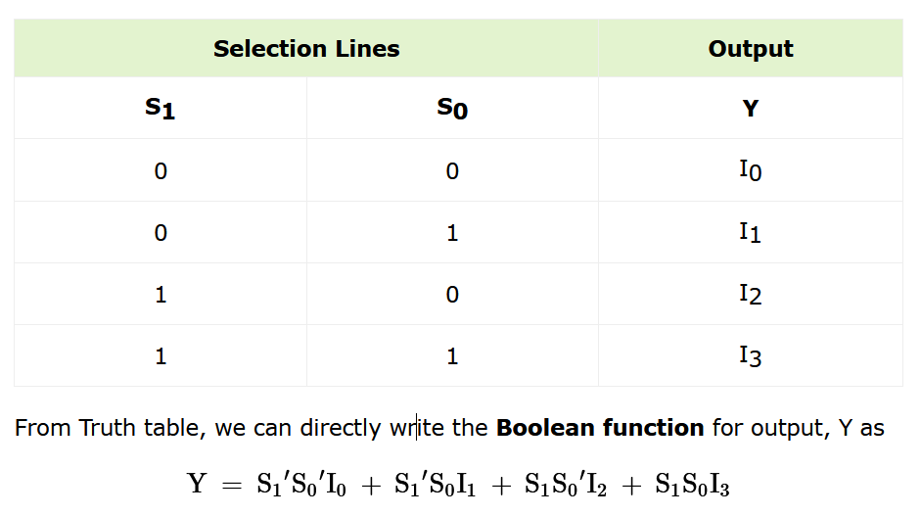
4-1 Multiplexer
One of these 4 inputs will be connected to the output based on the combination of inputs present at these two selection lines. Truth table of 4×1 Multiplexer is shown below
/46

Slide 15
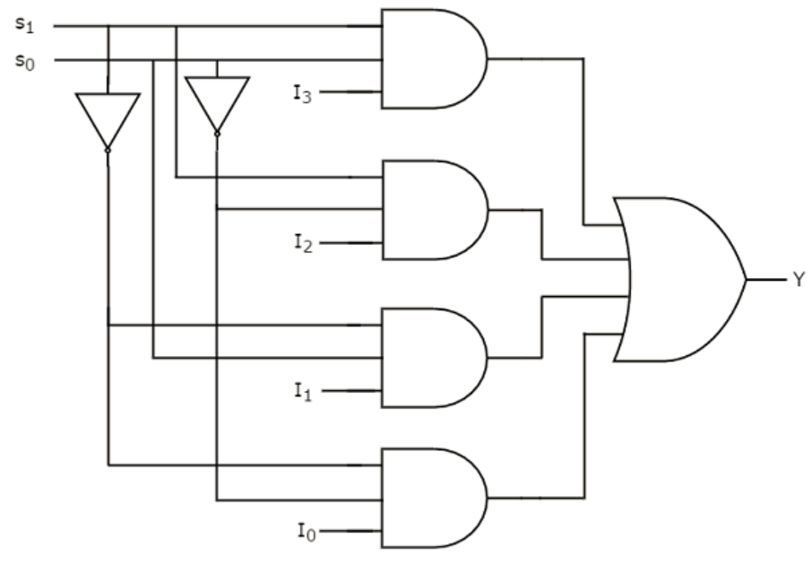
4-1 Multiplexer
We can implement this Boolean function using Inverters, AND gates & OR gate. The circuit diagram of 4×1 multiplexer is shown in the following figure.
/46

Slide 16
A Demultiplexer
A Demultiplexer is a combinational logic circuit that accepts a single input and distributes it over several output lines. It performs the opposite function of a multiplexer.i.e., it selectively passes the input to one of the outputs depending on a control signal.
As Demultiplexer is used to transmit the same data to different destinations, hence it is also known as data distributor.
There is another combinational logic circuit named multiplexer which performs opposite operation of the Demultiplexer, i.e. accepts several inputs and transmits one of them at time to the output line.
/46

Slide 17
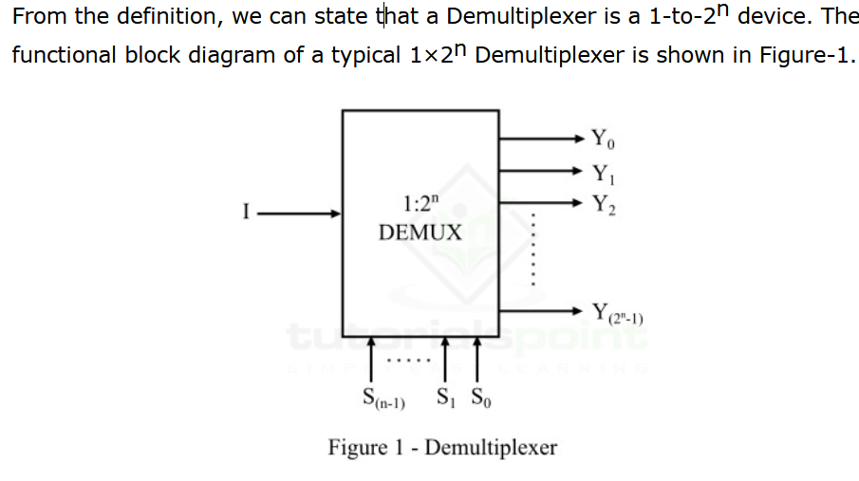
A Demultiplexer
It can be seen that the Demultiplexer has only one data input line, 2^{n} output lines, and n select lines. The logic level applied to select lines of the Demultiplexer determines the output channel to which the input data will be transmitted.
/46

Slide 18
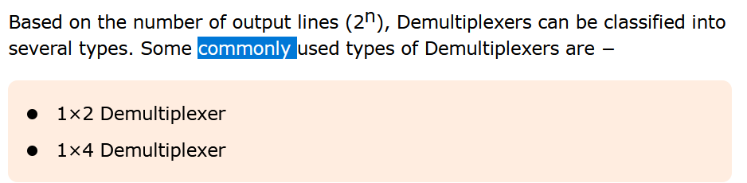
Types of Demultiplexer
/46

Slide 19
A 1- 2 Demultiplexer
It has 1 data input (A) , two outputs( X, Y) and one control input (P) .
A
P DMUX(n)
X Y
P A X Y
0 0 0 0
0 1 1 0
1 0 0 0
1 1 0 1
X = PA; Y = PA
A
P
X Y
/46

Slide 20
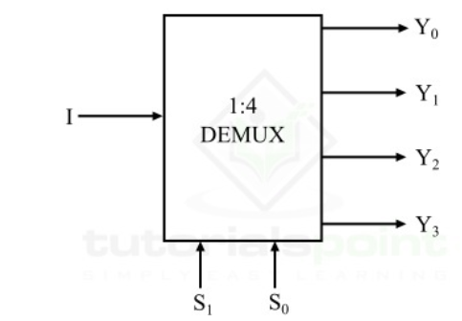
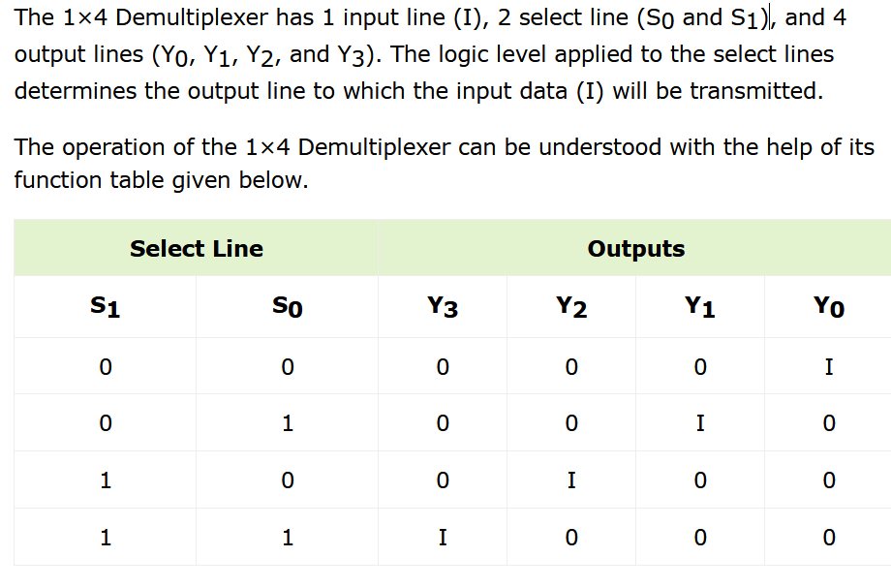
1×4 Demultiplexer
/46

Slide 21
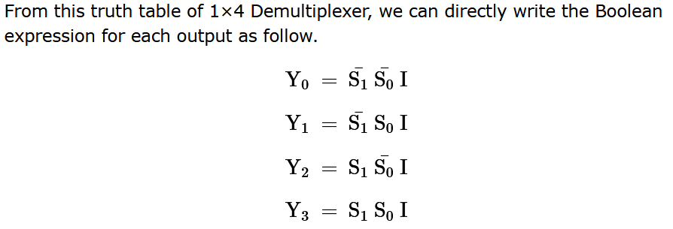
1×4 Demultiplexer
/46

Slide 22
Comparators
A comparator compares two sets of inputs and outputs a 1 if the comparison is satisfied.
The comparisons are =,!=, >, >=, <, <=
Inputs
A B
output
For equality comparator, the design is based upon the XNOR gate which outputs a 1 if its inputs are the same and a 0 if they are not equal.
/46

Slide 23
1 bit > comparator
The output is 1 if A > B
A B X
0 0 0
0 1 0
1 0 1
1 1 0
X = AB
A B
X
/46

Slide 24
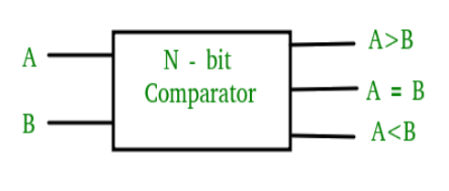
2-BIT COMPARATOR
A comparator used to compare two binary numbers each of two bits is called a 2-bit magnitude comparator. It consists of four inputs and three outputs to generate less than, equal to and greater than between two binary numbers.
/46

Slide 25
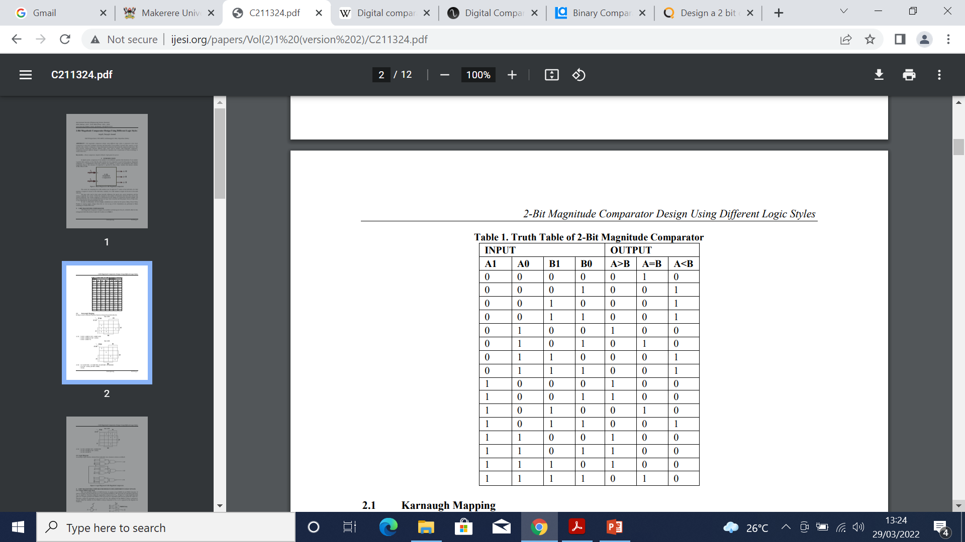
2-BIT COMPARATOR
A comparator used to compare two binary numbers each of two bits is called a 2-bit magnitude comparator. It consists of four inputs and three outputs to generate less than, equal to and greater than between two binary numbers.
/46

Slide 26
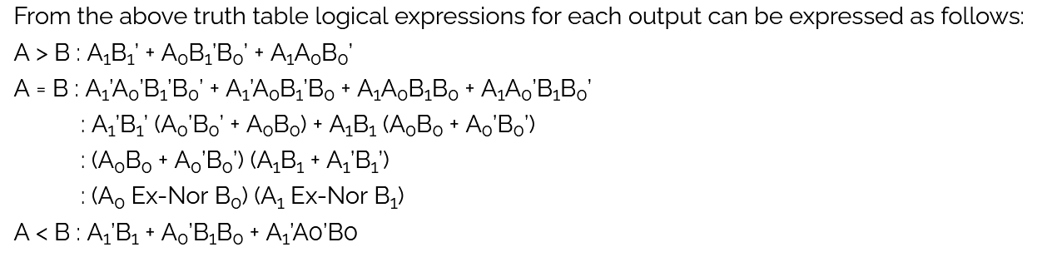
2-BIT COMPARATOR
/46

Slide 27
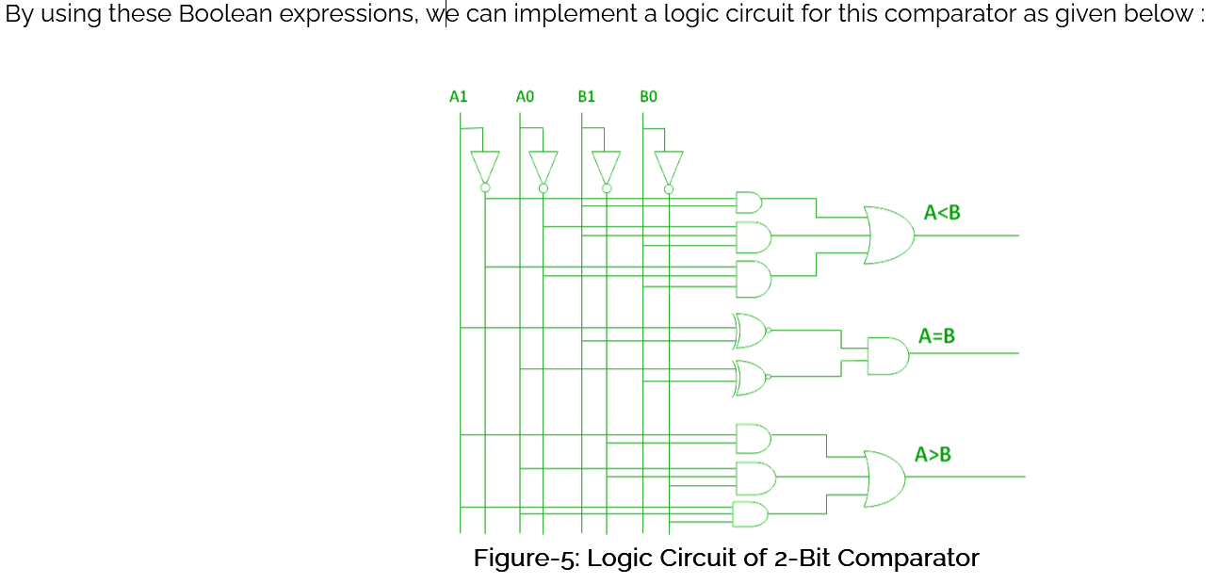

2-BIT COMPARATOR
/46

Slide 28
Decoder
A decoder is a combinational circuit that converts binary information from n input lines to a maximum 2^{n} unique output lines.
Circuit whose outputs are miniterms of the inputs. Exactly only one output is a 1 at any given time.
If n is the number of inputs and m the number of outputs then 2^{n} >= m
e.g. if the binary number on the input lines is k then output line k will be 1 and all the others will be 0’s.
A₁ A₂ A₃ X₀ X₁ X₂ X₃ X₄ X₅ X₆ X₇
0 0 0 1 0 0 0 0 0 0 0
0 0 1 0 1 0 0 0 0 0 0
0 1 0 0 0 1 0 0 0 0 0
0 1 1 0 0 0 1 0 0 0 0
1 0 0 0 0 0 0 1 0 0 0
1 0 1 0 0 0 0 0 1 0 0
1 1 0 0 0 0 0 0 0 1 0
1 1 1 0 0 0 0 0 0 0 1
/46

Slide 29
Decoder
A3
A2
A1
X₀ X₁ X₂ X₃ X₄ X₅ X ₆ X₇
/46

Slide 30
The Encoder
The opposite of a decoder. Only one input can be a 1 (activated) at a time. Its number in binary is presented as the output.
It has 2^{n} inputs and n outputs.
A₀ A₁ A₂ A₃ X₁ X₂
1 0 0 0 0 0
0 1 0 0 0 1
0 0 1 0 1 0
0 0 0 1 1 1
Inputs Outputs
A₁ A₂ A₃ A₄ A₅ X₁ X₂ X₃
1 0 0 0 0 0 0 1
0 1 0 0 0 0 1 0
0 0 1 0 0 0 1 1
0 0 0 1 0 1 0 0
0 0 0 0 1 1 0 1
X₃ = A₁ + A₃ + A₅ X₂ = A₂ + A₃ X₁ = A₄ + A₅
/46

Slide 31
Encoder
X₃ = A₁ + A₃ + A₅ X₂ = A₂ + A₃ X₁ = A₄ + A₅
A₁
A₂
A₃
A₄
A₅
X₃ X₂ X₁
/46

Slide 32
Code Converters
They are electronic circuits whose purpose is to convert data from one format to another.
Data in a computer system may take on several different forms as it changes from one format to another.
e.g. the decimal input from a keyboard calculator must be converted into BCD using an encoder.
The CPU’s output is in BCD and the decoder translates the BCD to a special 7 segment display code.
7 8 9
4 5 6 Encoder CPU Decoder
1 2 3
0 Decimal
Keyboard Display
/46

Slide 33
The encoder circuit
The encoder has 10 active inputs and 4 outputs connected to input lamps.
e.g. The input 7 causes a BCD output of 0111.
9 2³ 2² 2¹ 2⁰
9
8 8 A
7 7 DECIMAL
6 6 TO
5 BCD ENCODER B
5 4
4 3 C
3 2
2 1 D
1 0
0
/46

Slide 34
The Decoder circuit
0 A a a
b b
1 B c c
Decoder d d
1 C e e Display
f f
1 D g g
/46

Slide 35
The Display
a
f b
g
e c
d
A B C D a b c d e f g
0 0 0 0 1 1 1 1 1 1 0
0 0 0 1 0 1 1 0 0 0 0
0 0 1 0 1 1 0 1 1 0 1
0 0 1 1 1 1 1 1 0 0 1
0 1 0 0 0 1 1 0 0 1 1
0 1 0 1 1 0 1 1 0 1 1
0 1 1 0 0 0 1 1 1 1 1
0 1 1 1 1 1 1 0 0 0 0
1 0 0 0 1 1 1 1 1 1 1
1 0 0 1 1 1 1 0 0 1 1
/46

Slide 36
Read-Only Memory (ROM)
Memory that is implemented with combinational circuits
  Combinational circuits are often referred to as “memoryless” circuits because their output depends only on their current input and no history of prior inputs is retained.
Memory unit that performs only the read operation.
  Binary information stored in a ROM is permanent and is created during the fabrication process
  A given input to the ROM (address lines) always produces the same output (data lines).
  Because the outputs are a function only of the present inputs, ROM is a combinational circuit
/46
Notes:
Combinational circuits are often referred to as “memoryless” circuits, because their output depends only on their current input and no history of prior inputs is retained. However, there is one sort of memory that is implemented with combinational circuits, namely read-only memory (ROM).
Recall that a ROM is a memory unit that performs only the read operation. This implies that the binary information stored in a ROM is permanent and was created during the fabrication process. Thus, a given input to the ROM (address lines) always produces the same output (data lines). Because the outputs are a function only of the present inputs, the ROM is in fact a combinational circuit.

Slide 37
ROM(Read Only Memory)
ROM (Read Only Memory)
ROM includes both decoder and OR gates in a single device. It outputs all possible miniterms of the inputs followed by an encoder.
The output combinations are permanently embedded in its circuitry and the inputs serve to select one of these combinations. Each output is obtained by disconnecting the OR inputs from the AND gates whose miniterms are not to be included in the output.
Because a ROM must produce all the possible miniterms its decoder portion is fixed by n (the number of inputs). The encoder portion depends on both the outputs and the way in which all the outputs of a decoder are used to generate the final ROM outputs.
/46

Slide 38
ROMS
A₁ X₁
DECODER 2^{n} miniterms ENCODER
A_{n} X_{n}
Once the disconnections are made they cannot be changed. (ROM nature)
EXAMPLE
Construct a 2 input ( A,B) and 3 output (X,Y,Z) ROM such that:
X = AB + AB; Y = AB + AB; Z = AB + AB
/46

Slide 39
ROM EXAMPLE
A These
connections
are always
B made
AB AB AB AB
These are
selectively
made
X Y Z
/46

Slide 40
PLA (Programmed Logic Array)
Similar to a ROM but does not output miniterms that will not be needed in any of the outputs. i.e. the decoder does not necessarily produce all the miniterms. For an n input network, we have <= 2^{n} AND gates
A₁ X₁
DECODER < 2^{n} miniterms ENCODER
A_{n} X_{n}
EXAMPLE
Implementation of the above ROM as a PLA
/46

Slide 41
PLA example
A
B
Both sets of
connections are
AB AB AB made selectively
X Y Z
/46

Slide 42
Reading Assignment 4
1. Read and make notes on the following circuits:
  Half Subtractor
  Full Subtractor
  Note:
  Examine the 4 steps you go through to design the circuit.
/46

Slide 43
PARITY GENERATION AND DETECTION
Errors usually occur when transmitting or storing data due to electromagnetic noise or physical damage to the storage medium.
One method of error protection is by adding an extra bit called a parity bit to the data bits and it is set according to one of the following rules:
An Even Parity bit is set if an odd number of 1’s occurs in the data bits; otherwise it is cleared. Therefore, the total number of 1’s is even.
An Odd Parity bit is set if an even number of 1’s occurs in the data bits; otherwise it is cleared. Therefore, the total number of 1’s is odd.
/46

Slide 44
PARITY GENERATION AND DETECTION
During transfer of information from one location to another, the message (the data bits) is applied to the parity generator where the required parity bit is generated.
The message together with the parity bit is transmitted to its destination.
/46

Slide 45
PARITY GENERATION AND DETECTION
At the destination all the incoming bits are applied to a parity checker to check the proper parity which was adopted.
An error is detected if the checked parity does not conform to the adopted parity.
The parity method detects the presence of 1, 3 or any odd number of errors. An even number of errors is not detected.
/46

Slide 46
Example (Even Parity)
Parity Generation
Parity bit
Data Bits
Error Detection
1 if there is an error
0 if no error
Parity Bit
Data Bits
/46

